Slide 1
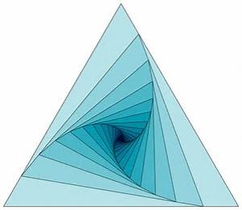


High
School
Positive Behavior Interventions and Supports
HS-PBIS
Community of Practice #1
Agenda
School Climate: Academic Achievement & Social Behavior Competence
HS-PBIS Implementation Successes & Challenges
Student Voice and Involvement
Classroom Practices: Foundations
Tiered Fidelity Inventory: Tier 1 & 2 TEAMS
Behavior
Academics
Interconnecting School & Mental Health
Facilitator:
Cristy Clouse
cristy@pbiscaltac.org
Host:
Rachel Santos
Rachel.Santos@abcusd.org

Slide 2

High School
PBIS
Community of Practice
HS-PBIS COP
Shared Membership
High school educators & administrators
at various stages of HS-PBIS implementation
(exploration to refinement)
Shared Purpose
coming together with a common purpose
(insuring safe, positive equitable and
engaging high school campuses)
Shared Outcomes
sharing experiences, refining skills and
working towards a common goal
(sustainable systems, practices and
data supporting positive academic, behavior and social-emotional outcomes for ALL students).

Slide 3

https://www.youtube.com/watch?v=hwhvByj8YG8
Morning
Revolving
Reflections
FIND
YOUR
FIVE
https://www.youtube.com/watch?v=hwhvByj8YG8
Notes:
Hawaii 5 O music – pair up with 5 people from another table
Find way to charts
6 charts in room.
Name/District/Position
Histogram – sticky dots
Stages and description – sticky dots
Large post its
Large post its
Generate outcomes from input
Play music to rotate every 5 minutes

Slide 4
HS-PBIS Learning Community Model
Name/District/Position
How long have you been implementing PBIS on your campus or in your district?
Where are you with regards to stages of implementation?
(exploration, initial implementation, full implementation, regeneration)
What do you hope to achieve attending the
HS-PBIS Community of Practice?
Why do you want to be a part of a
HS-PBIS Community of Practice?
Morning
Revolving
Reflections
https://www.youtube.com/watch?v=hwhvByj8YG8
Notes:
Hawaii 5 O music – pair up with 5 people from another table
Find way to charts
6 charts in room.
Name/District/Position
Histogram – sticky dots
Stages and description – sticky dots
Large post its
Large post its
Generate outcomes from input
Play music to rotate every 5 minutes

Slide 5
School Climate:
Academic Achievement and Social Behavior Competence
Adapted from the Technical Brief; Center for Positive Behavioral Interventions and Supports
September 14, 2016
Why is school climate important for all students and educators?
www.startwithwhy.com
Notes:
Table question – review #2

Slide 6
School Climate:
Academic Achievement and Social Behavior Competence
Adapted from the Technical Brief; Center for Positive Behavioral Interventions and Supports
September 14, 2016
WHAT IS SCHOOL CLIMATE?
NEGATIVE School/Classroom CLIMATE Examples |  | POSITIVE School/Classroom CLIMATE Examples
High School Students | High School Educators | High School Students | High School Educators
Notes:
Table 1:
Read / Review Chart / Develop HS perspective / Share with Group

Slide 7
School Climate:
Academic Achievement and Social Behavior Competence
Adapted from the Technical Brief; Center for Positive Behavioral Interventions and Supports
September 14, 2016
HOW IS SCHOOL CLIMATE MEASURED?
Observation Indicators High School STUDENTS |  | Observation Indicators High School EDUCATORS
Notes:
Table 2:
Read / Review Chart / Develop HS perspective / Share with Group

Slide 8
School Climate:
Academic Achievement and Social Behavior Competence
Adapted from the Technical Brief; Center for Positive Behavioral Interventions and Supports
September 14, 2016
WHAT PRACTICES AND SYSTEMS ARE ASSOCIATED WITH THE DEVELOPMENT, SUSTAINABILITY AND ENHANCEMENT OF POSITIVE SCHOOL CLIMATE?
Effective High School PRACTICES |  | Effective High School Supporting SYSTEMS
Notes:
Table 3:
Read / Review Chart / Develop HS perspective / Share with Group

Slide 9
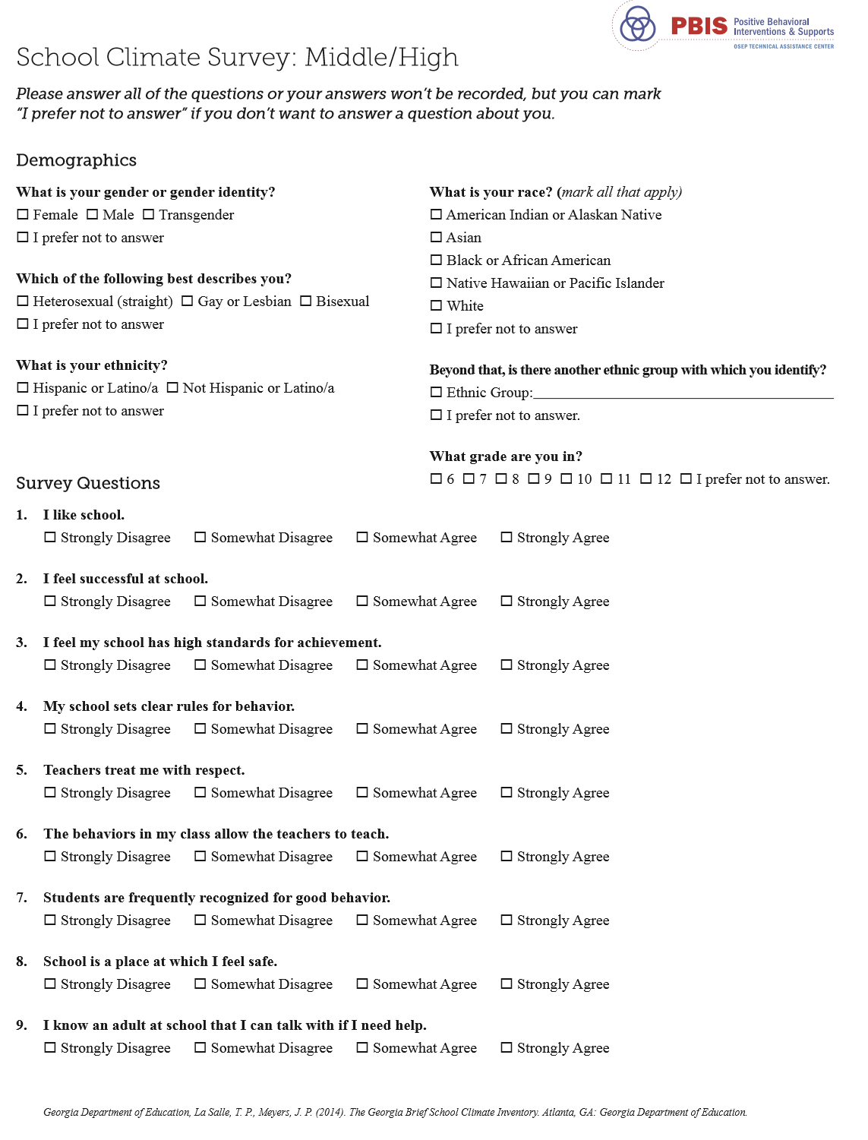
School Climate Survey is a survey to provide schools with an overall understanding of how secondary students perceive school climate along three dimensions: teaching and learning, relationships, and safety. High school students complete the survey during school hours using campus computers under the guidance of teachers or other appropriate school personnel. The time to complete the survey is approximately 10 minutes.
Notes:
Share on line with group – talk about questions asked:

Slide 10
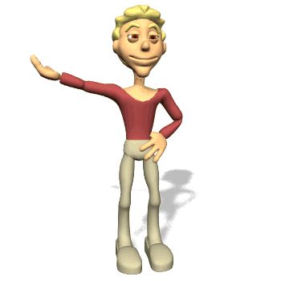
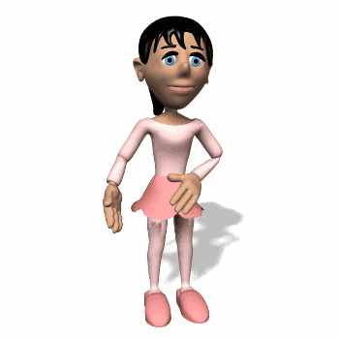
STRETCH BREAK

Slide 11
Size
Culture
Developmental Level
High School Implementation Considerations
https://www.youtube.com/watch?v=45xNIfyHgBY
Data
Leadership
Communi-cation
DATA
SYSTEMS
PRACTICES
SCHOOL ENGAGEMENT & SUCCESS
Social Behavior
Academic Success
Personalization/ School Belonging
Freshman Support
Contextual
Influences
Key Foundational
Systems
Core Features
of Implementation
Key Focus
Areas
Notes:
Webinarhttps://www.youtube.com/watch?v=45xNIfyHgBY

Slide 12
High School Implementation
Successes | Challenges
Data
Leadership
Communi-cation
DATA
SYSTEMS
PRAC-TICES
SCHOOL ENGAGEMENT & SUCCESS
Social Behavior
Academic Success
Personalization/ School Belonging
Freshman Support
Size
Culture
Developmental Level
Notes:
Pairing – Strengths and Challenges
Share with 4 find new people
Share with 8 – post combine groups to chart and share out

Slide 13
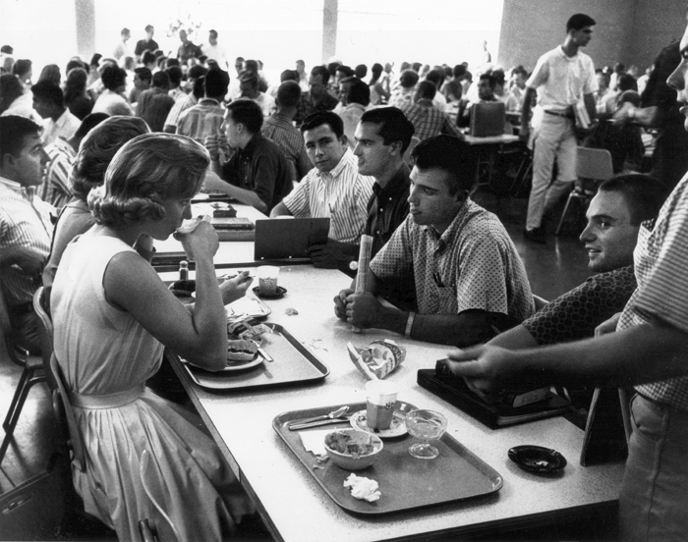
We will meet back at 12:20.
ENJOY
the lunch menu.

Slide 14
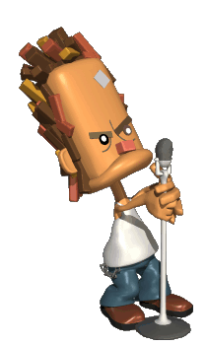
Tiered Fidelity Inventory TFI 1.1 Team Composition | Tiered Fidelity Inventory TFI 1.11 Student/Family/ Community Involvement
Tier I team includes a Tier I systems coordinator, a school administrator, a family member, and individuals able to provide (1) applied behavioral expertise, (2) coaching expertise, (3) knowledge of student academic and behavior patterns, (4) knowledge about the operations of the school across grade levels and programs, and for high schools, (5) student representation. | Stakeholders provide input on universal foundations every 12 months. Expectations Teaching expectations Consequences Acknowledgments
Student
Voice and Involvement
SWPBIS
is something we do WITH students
not to them

Slide 15
Why Give Students a Voice in SWPBIS Implementation?
Students are being increasingly disengaged from schools and we need to give them a voice in reforms to increase engagement.
For SWPBIS implementation to be successful, student input is critical in ensuring student engagement.
By gathering input and involving students in SWPBIS Implementation, we move from things being “done to them” to “working with them”.
If SWPBIS is implemented school-wide, then we need input from ALL members of our school community and above all else STUDENTS.
Giving students a voice in school priorities and reforms is an effective way to improve student outcomes.
Increasing student voice in schools and seeking students’ perspective helps create a shift towards a more positive school climate.
Schools with a positive school culture are more effective.
Emphasizing a relationship between teachers and students increases respect and positive relationships (Cook-Sather, 2006)
Builds support and sustainability for initiatives (Fieldings, 2001; Rudduck, 2007)
Student
Voice and Involvement
SWPBIS
is something we do WITH students
not to them
Notes:
mip

Slide 16
STUDENT VOICE PROJECTS
With high schoolers, it’s important to communicate two things:
  I care about you and want you here
  I care about what you think and how you feel
Getting their input and allowing them to share with you what works for them
makes everything better!
Use Another Word
https://www.youtube.com/watch?v=GM-nWXz1YHo
Student
Voice and Involvement
SWPBIS
is something we do WITH students
not to them
Notes:
Video access

Slide 17

Teaching Expectations at the High School Level
Tiered Fidelity Inventory TFI 1.4 Teaching Positive Behavioral Expectations Discipline is critical in establishing safe and positive schools in an environment conducive to learning. A teaching approach to discipline has enduring results because new behaviors are taught and learned. Teaching acceptable social behaviors requires that behavior is functional, predictable and changeable. (Crone, & Horner, 2003)
Strengths | Concerns
Students are capable of using higher order reasoning skills (Formal Operations) Students can participate in the creation and execution of behavior lessons plans Teacher-friendly multi-modal materials can be utilized Facilitates student/teacher connections and relationships | High School teachers are trained for specific content areas Expectation is often that young adult should have mastered behavioral skills Scheduling is based on credit completion Behavioral lessons must be developmentally and culturally appropriate
Considerations: SWPBIS team/subcommittee create a schedule and lesson plans that include three to five options for teacher and student activities. SWPBIS team create a system to enlist student input and/or active role in writing lesson plans.
Student
Voice and Involvement
SWPBIS
is something we do WITH students
not to them
Notes:
Table Talk about strengths/concerns

Slide 18
Teaching Expectations at the
High School Level With Student Voice
Step One: Map It! Identify Predictable Problem Behaviors
Step Two: Define it! Undesired vs. Desired T-Chart
Step Three: Make it a Matrix! Re-classify Desired Behaviors
Step Four: Make it Come Alive! Lesson Planning and Roll Out
How do we enlist students with
Teaching Positive Behavioral Expectations,
at a high school level?

Slide 19
Building Classroom Routines with Student Voice
CLASSROOM ROUTINES | Positive Behavioral Expectation:
Agenda/To-Do’s/ Today’s Work Routine
Entering the Classroom
Turning in Assignments
Assignment Tracking
How do we include
Student Voice
in the development of
classroom routines?

Slide 20

2
1
How do we include
Student Voice
in the development of
classroom routines?
How do we enlist students with
Teaching Positive Behavioral Expectations,
at a high school level?

Slide 21
TIERED
FIDELITY
INVENTORY
TEAMS
Exploring their
similarities and
differences
PBIS
Mental
Health
Aca-
demics
Notes:
Venn Diagram at their tables/share out

Slide 22

1 NEVER | 2 MINIMALY | 3 SOMEWHAT | 4 MOSTLY | 5 ALWAYS
HS
Leadership Teams
On a scale of
1 to 5
INTEGRATED APPROACH
FEW MEASURABLE GOALS
PROFESSIONAL DATA CULTURE
ORGANIZATIONAL HEALTH
PERSONALIZATION OF SOCIAL AND ACADEMIC LEARNING
ENGAGEMENT
Notes:
Data chart on wall – sticky dots

Slide 23

One word to describe Dr. McIntosh’s presentation.
Two considerations for implementation.
Closing
Circles
Three new ideas.
Notes:
Circles need talking piece

Slide 24

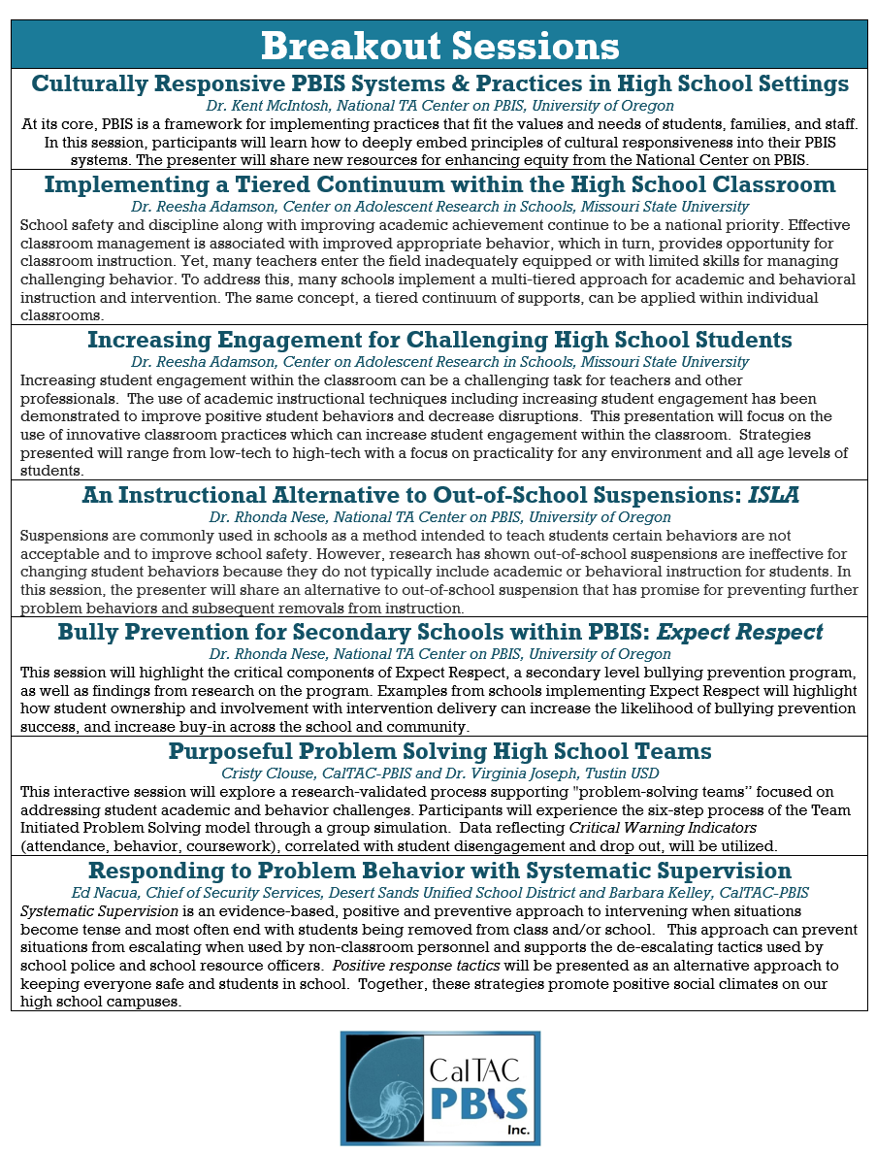
FEBRUARY 15, 2017
COP #2
Debriefing
the CA HS-PBIS Symposium
Equity
Engagement
Bully Prevention
Systematic Supervision and De-Escalation Strategies
Alternative to Suspension

